Slide 1
Network Applications: Load Balancing among Homogeneous Servers; Application Overlays (P2P)
Qiao Xiang
https://qiaoxiang.me/courses/cnns-xmuf21/index.shtml
11/4/2021
This deck of slides are heavily based on CPSC 433/533 at Yale University, by courtesy of Dr. Y. Richard Yang.

Slide 2
Outline
Admin and recap
Multi-servers
Basic issues
Load direction
DNS (IP level)
Load balancer/smart switch (sub-IP level)
Application overlays (distributed network applications) to
scale bandwidth/resource (BitTorrent)

Slide 3
Admin
Assignment three status and questions?
Midterm exam 1: Thursday next week (i.e., Nov. 11)
cover from lecture 1 to lecture 16 (the one on Nov. 9)

Slide 4
Recap: Direction Mechanisms
App
DNS name1
DNS name2
- cname
- hierarchy
IP1
IP2
IPn
Cluster1 in US East
Cluster2
in US West
Cluster2
in Europe
Smart switch/LB - NAT rewrite - Direct reply - NLB
Load
balancer
Proxy as a mechanism for replica content consistency
Load
balancer
proxy
servers
4

Slide 5
VIP Clustering
Goals
server load balancing
failure detection
access control filtering
priorities/QoS
request locality
transparent caching
L4: TCP
L7: HTTP
SSL
etc.
virtual IP addresses (VIPs)
smart switch
Clients
What to switch/filter on?
L3 source IP and/or VIP
L4 (TCP) ports etc.
L7 URLs and/or cookies
L7 SSL session IDs
server array

Slide 6
Load Balancer (LB): Basic Structure
RIP1
S=client
D=VIP
Server1
S=client
D=VIP
VIP
RIP2
Client
LB
Server2
RIP3
Server3
Problem of the basic structure?

Slide 7
Problem
S=client
D=VIP
Client to server packet has VIP as destination address, but real servers use RIPs
if LB just forwards the packet from client to a real server, the real server drops the packet
reply from real server to client has real server IP as source -> client will drop the packet
state: listening
address: {RealIP.6789, *:*}
completed connection queue: C1; C2 sendbuf:
recvbuf:
state:
address: {VIP:6789, 198.69.10.10.1500}
sendbuf:
recvbuf:
…
state:
address: {RealIP:6789, 198.69.10.10.1500}
sendbuf:
recvbuf:
…
server
client

Slide 8
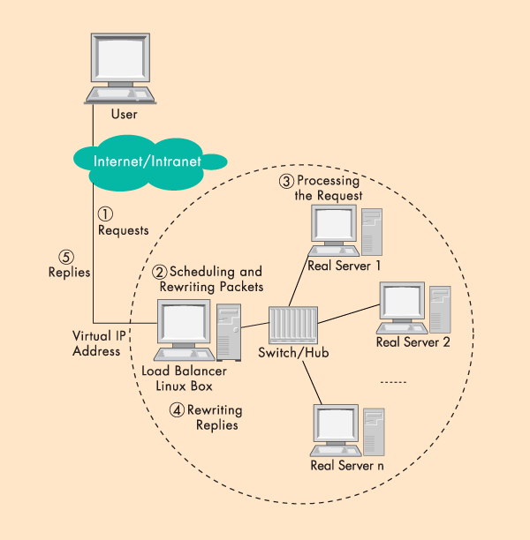
Solution 1: Network Address Translation (NAT)
LB does rewriting/ translation
Thus, the LB is similar to a typical NAT gateway with an additional scheduling function
Load Balancer

Slide 9
Example Virtual Server via NAT

Slide 10
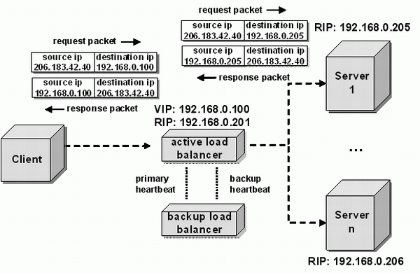
LB/NAT Flow

Slide 11
LB/NAT Flow

Slide 12
LB/NAT Advantages and Disadvantages
Advantages:
Only one public IP address is needed for the load balancer; real servers can use private IP addresses
Real servers need no change and are not aware of load balancing
Problem
The load balancer must be on the critical path and hence may become the bottleneck due to load to rewrite request and response packets
Typically, rewriting responses has more load because there are more response packets

Slide 13
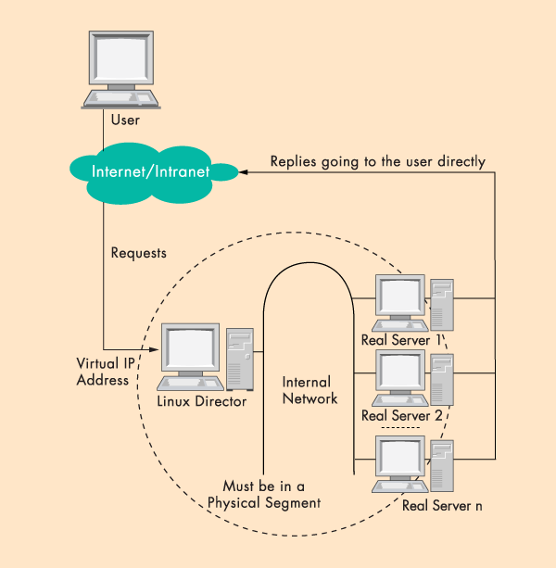
Goal: LB w/ Direct Reply
load
balancer
Connected
by a single switch

Slide 14
LB with Direct Reply: Implication
VIP
Server1
VIP
Client
LB
Server2
Server3
Direct reply
Each real server uses VIP as its IP address
Address conflict: multiple devices w/ the same IP addr

Slide 15
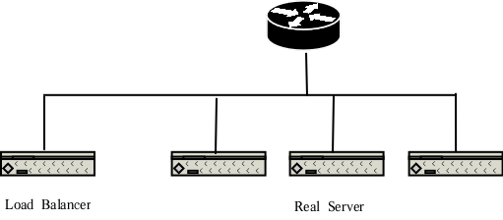
Why IP Address Matters?
VIP
Each network interface card listens to an assigned MAC address
A router is configured with the range of IP addresses connected to each interface (NIC)
To send to a device with a given IP, the router needs to translate IP to MAC (device) address
The translation is done by the Address Resolution Protocol (ARP)

Slide 16
ARP Protocol
ARP is “plug-and-play”:
nodes create their ARP tables without intervention from net administrator
A broadcast protocol:
Router broadcasts query frame, containing queried IP address
all machines on LAN receive ARP query
Node with queried IP receives ARP frame, replies its MAC address

Slide 17
ARP in Action
S=client
D=VIP
Router R
VIP
- Router broadcasts ARP broadcast query: who has VIP?
- ARP reply from LB: I have VIP; my MAC is MAC_{LB}
- Data packet from R to LB: destination MAC = MAC_{LB}

Slide 18
LB/DR Problem
Router R
VIP
VIP
VIP
VIP
ARP and race condition:
When router R gets a packet with dest. address VIP, it broadcasts an Address Resolution Protocol (ARP) request: who has VIP?
One of the real servers may reply before load balancer
Solution: configure real servers to not respond to ARP request

Slide 19
LB via Direct Routing
The virtual IP address is shared by real servers and the load balancer.
Each real server has a non-ARPing, loopback alias interface configured with the virtual IP address, and the load balancer has an interface configured with the virtual IP address to accept incoming packets.
The workflow of LB/DR is similar to that of LB/NAT:
the load balancer directly routes a packet to the selected server
the load balancer simply changes the MAC address of the data frame to that of the server and retransmits it on the LAN (how to know the real server’s MAC?)
When the server receives the forwarded packet, the server determines that the packet is for the address on its loopback alias interface, processes the request, and finally returns the result directly to the user

Slide 20
LB/DR Advantages and Disadvantages
Advantages:
Real servers send response packets to clients directly, avoiding LB as bottleneck
Disadvantages:
Servers must have non-arp alias interface
The load balancer and server must have one of their interfaces in the same LAN segment
Considered by some as a hack, not a clean architecture

Slide 21
Example Implementation of LB
An example open source implementation is Linux virtual server (linux-vs.org)
Used by
www.linux.com
sourceforge.net
wikipedia.org
More details on ARP problem: http://www.austintek.com/LVS/LVS-HOWTO/HOWTO/LVS-HOWTO.arp_problem.html
Many commercial LB servers from F5, Cisco, …
More details please read chapter 2 of Load Balancing Servers, Firewalls, and Caches

Slide 22
Problem of the Load Balancer Architecture
Server1
S=client
D=VIP
VIP
Client
LB
Server2
Server3
One major problem is that the LB becomes a single point of failure (SPOF).

Slide 23
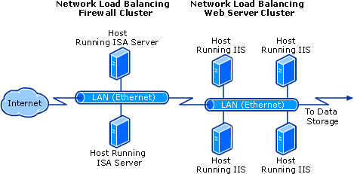
Solutions
Redundant load balancers
E.g., two load balancers (a good question to think offline)
Fully distributed load balancing
e.g., Microsoft Network Load Balancing (NLB)

Slide 24
Microsoft NLB
No dedicated load balancer
All servers in the cluster receive all packets
Key issue: one and only one server processes each packet
All servers within the cluster simultaneously run a mapping algorithm to determine which server should handle the packet. Those servers not required to service the packet simply discard it.
Mapping (ranking) algorithm: computing the “winning” server according to host priorities, multicast or unicast mode, port rules, affinity, load percentage distribution, client IP address, client port number, other internal load information
http://technet.microsoft.com/en-us/library/cc739506%28WS.10%29.aspx

Slide 25
Discussion
Compare the design of using Load Balancer vs Microsoft NLB

Slide 26
Recap: Direction Mechanisms
App
DNS name1
DNS name2
IP1
IP2
IPn
Cluster1 in US East
Cluster2
in US West
Cluster2
in Europe
Rewrite
Direct reply
Fault tolerance
Load
balancer
Load
balancer
proxy
servers

Slide 27
Outline
Admin and recap
Single, high-performance network server
Multiple servers
Overview
Basic mechanisms
Example: YouTube (offline read)

Slide 28
You Tube
http://video.google.com/videoplay?docid=-6304964351441328559#
02/2005: Founded by Chad Hurley, Steve Chen and Jawed Karim, who were all early employees of PayPal.
10/2005: First round of funding ($11.5 M)
03/2006: 30 M video views/day
07/2006: 100 M video views/day
11/2006: acquired by Google
10/2009: Chad Hurley announced in a blog that YouTube serving well over 1 B video views/day (avg = 11,574 video views /sec )

Slide 29
Pre-Google Team Size
2 Sysadmins
2 Scalability software architects
2 feature developers
2 network engineers
1 DBA
0 chefs

Slide 30
YouTube Design Alg.
while (true) { identify_and_fix_bottlenecks(); drink(); sleep(); notice_new_bottleneck(); }

Slide 31
YouTube Major Components
Web servers
Video servers
Thumbnail servers
Database servers

Slide 32
YouTube: Web Servers
Components
Netscaler load balancer; Apache; Python App Servers; Databases
Python
Web code (CPU) is not bottleneck
JIT to C to speedup
C extensions
Pre-generate HTML responses
Development speed more important
NetScaler
Apache
Web
servers
Python
App Server
Databases

Slide 33
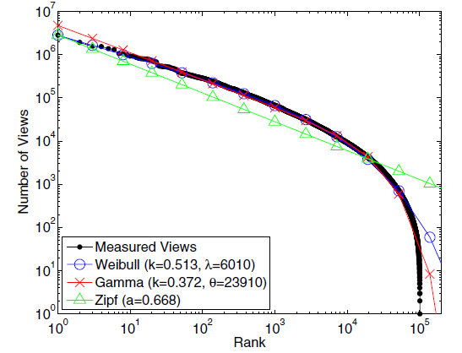
YouTube: Video Popularity
See “Statistics and Social Network of YouTube Videos”, 2008.

Slide 34
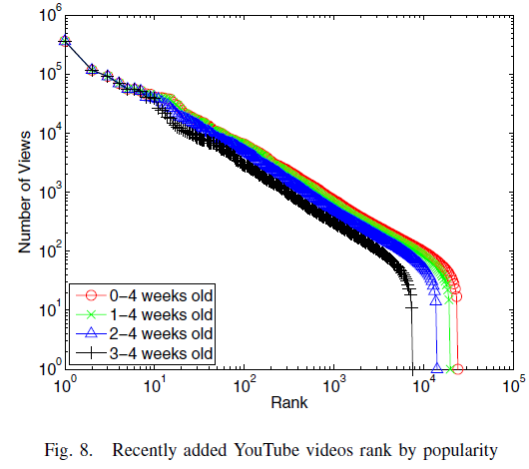
YouTube: Video Popularity
How to design a system to handle highly skewed distribution?
See “Statistics and Social Network of YouTube Videos”, 2008.

Slide 35
YouTube: Video Server Architecture
Tiered architecture
CDN servers (for popular videos)
Low delay; mostly in-memory operation
YouTube servers (not popular 1-20 per day)
CDN
Most popular
YouTube Colo 1
Request
Others
YouTube Colo N

Slide 36
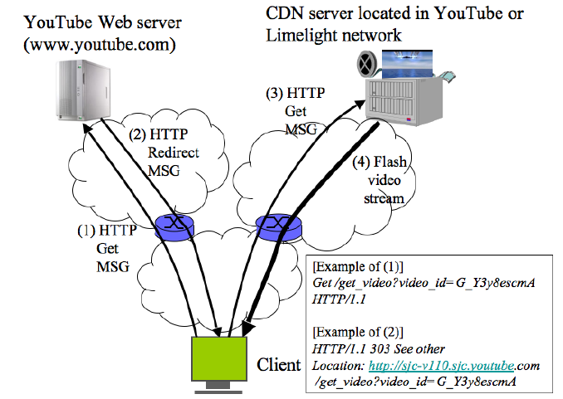
YouTube Redirection Architecture
YouTube servers

Slide 37
YouTube Video Servers
Each video hosted by a mini-cluster consisting of multiple machines
Video servers use the lighttpd web server for video transmission:
Apache had too much overhead (used in the first few months and then dropped)
Async io: uses epoll to wait on multiple fds
Switched from single process to multiple process configuration to handle more connections

Slide 38
Thumbnail Servers
Thumbnails are served by a few machines
Problems running thumbnail servers
A high number of requests/sec as web pages can display 60 thumbnails on page
Serving a lot of small objects implies
lots of disk seeks and problems with file systems inode and page caches
may ran into per directory file limit
Solution: storage switched to Google BigTable

Slide 39
Thumbnail Server Software Architecture
Design 1: Squid in front of Apache
Problems
Squid worked for a while, but as load increased performance eventually decreased: Went from 300 requests/second to 20
under high loads Apache performed badly, changed to lighttpd
Design 2: lighttpd default: By default lighttpd uses a single thread
Problem: often stalled due to I/O
Design 3: switched to multiple processes contending on shared accept
Problems: high contention overhead/individual caches

Slide 40
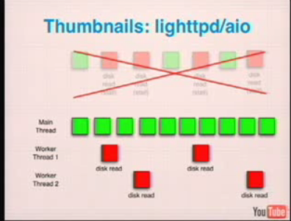
Thumbnails Server: lighttpd/aio

Slide 41
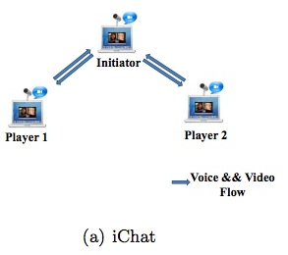
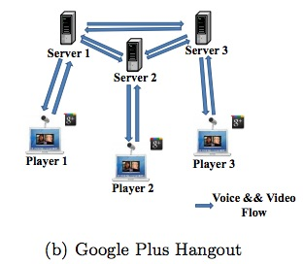
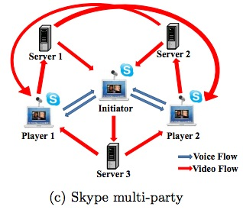
Example Server Systems
http://eeweb.poly.edu/faculty/yongliu/docs/imc12.pdf

Slide 42
Scalability of Server-Only Approaches
origin
DNS
edge. servers
C₀
client 1
client 2
client n
client 3

Slide 43
Outline
Admin and recap
Multiple servers
Application overlays
potential

Slide 44
An Upper Bound on Scalability
Idea: use resources from both clients and the server
Assume
need to achieve same rate to all clients
only uplinks can be bottlenecks
What is an upper bound on scalability?
server
C₀
C₁
client 1
C_{n}
C₂
C₃
client 2
client n
client 3

Slide 45
The Scalability Problem
Maximum throughput
R = min{C₀, (C₀+ΣC_{i})/n}
The bound is theoretically approachable
server
C₀
C₁
client 1
C_{n}
C₂
C₃
client 2
client n
client 3

Slide 46
Theoretical Capacity: upload is bottleneck
R = min{C₀, (C₀+ΣC_{i})/n}
Assume c₀ > (C₀+ΣC_{i})/n
Tree i: server → client i: c_{i} /(n-1) client i → other n-1 clients
Tree 0: server has remaining c_{m} = c0 – (c1 + c2 + … cn)/(n-1) send to client i: c_{m}/n
c₀
c_{i} /(n-1)
c_{n}
c_{i}
c₁
c₂
C₀
c_{m} /n
C_{n}
C₁
C₂
C_{i}

Slide 47
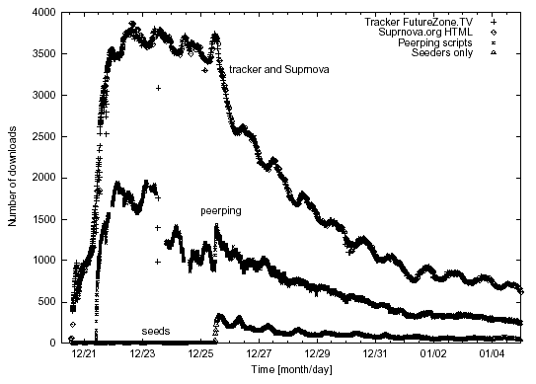
Why not Building the Trees?
servers
C₀
C₁
client 1
C_{n}
C₂
C₃
client 2
client n
Clients come and go (churns): maintaining the trees is too expensive
Each client needs N connections
client 3

Slide 48
Server+Host (P2P) Content Distribution: Key Design Issues
Robustness
Resistant to churns and failures
Efficiency
A client has content that others need; otherwise, its upload capacity may not be utilized
Incentive: clients are willing to upload
Some real systems nearly 50% of all responses are returned by the top 1% of sharing hosts
servers
C₀
C₁
client 1
C_{n}
C₂
C₃
client 2
client n
client 3

Slide 49
Discussion: How to handle the issues?
Robustness
Efficiency
Incentive
servers/ seeds
C₀
C₁
client 1
C_{n}
C₂
C₃
client 2
client n
client 3

Slide 50
Example: BitTorrent
A P2P file sharing protocol
Created by Bram Cohen in 2004
Spec at bep_0003: http://www.bittorrent.org/beps/bep_0003.html

Slide 51
BitTorrent: Lookup
HTTP GET MYFILE.torrent
MYFILE.torrent
webserver
http://mytracker.com:6969/
S3F5YHG6FEB
FG5467HGF367
F456JI9N5FF4E
…
user

Slide 52
Metadata (.torrent) File Structure
Meta info contains information necessary to contact the tracker and describes the files in the torrent
URL of tracker
file name
file length
piece length (typically 256KB)
SHA-1 hashes of pieces for verification
also creation date, comment, creator, …

Slide 53
Tracker Protocol
Communicates with clients via HTTP/HTTPS
Client GET request
info_hash: uniquely identifies the file
peer_id: chosen by and uniquely identifies the client
client IP and port
numwant: how many peers to return (defaults to 50)
stats: e.g., bytes uploaded, downloaded
Tracker GET response
interval: how often to contact the tracker
list of peers, containing peer id, IP and port
stats

Slide 54

Tracker Protocol
webserver
user
“register”
list of peers
ID1 169.237.234.1:6881
ID2 190.50.34.6:5692
ID3 34.275.89.143:4545
…
ID50 231.456.31.95:6882
tracker
…
Peer 50
Peer 1
Peer 2

Slide 55
Robustness and efficiency: Piece-based Swarming
Divide a large file into small blocks and request block-size content from different peers (why?)
If do not finish downloading a block from one peer within timeout (say due to churns), switch to requesting the block from another peer
Block: unit of download
File
Block: 16KB

Slide 56
Detail: Peer Protocol
(Over TCP)
Peers exchange bitmap representing content availability
bitfield msg during initial connection
have msg to notify updates to bitmap
to reduce bitmap size, aggregate multiple blocks as a piece
BitField/have
BitField/have
Remote Peer
Local Peer
0
1
0
1
Piece 256KB
Incomplete Piece

Slide 57

Peer Request
http://www.bittorrent.org/beps/bep_0003.html
If peer A has a piece that peer B needs, peer B sends interested to A
unchoke: indicate that A allows B to request
request: B requests a specific block from A
piece: specific data
1.interested/ 3. request
2. unchoke/ 4. piece

Slide 58
Key Design Points
request:
which data blocks to request?
unchoke:
which peers to serve?
1.interested/ 3. request
2. unchoke/ 4. piece

Slide 59
Request: Block Availability
Request (local) rarest first
achieves the fastest replication of rare pieces
obtain something of value

Slide 60
Block Availability: Revisions
When downloading starts (first 4 pieces): choose at random and request them from the peers
get pieces as quickly as possible
obtain something to offer to others
Endgame mode
defense against the “last-block problem”: cannot finish because missing a few last pieces
send requests for missing pieces to all peers in our peer list
send cancel messages upon receipt of a piece

Slide 61
BitTorrent: Unchoke
Periodically (typically every 10 seconds) calculate data-receiving rates from all peers
Upload to (unchoke) the fastest
constant number (4) of unchoking slots
partition upload bw equally among unchoked
1.interested/ 3. request
2. unchoke/ 4. piece
commonly referred to as “tit-for-tat” strategy

Slide 62
Optimistic Unchoking
Periodically select a peer at random and upload to it
typically every 3 unchoking rounds (30 seconds)
Multi-purpose mechanism
allow bootstrapping of new clients
continuously look for the fastest peers (exploitation vs exploration)

Slide 63
BitTorrent Fluid Analysis
Normalize file size to 1
x(t): number of downloaders (also known as leechers) who do not have all pieces at time t.
y(t): number of seeds in the system at time t.
λ: the arrival rate of new requests.
μ: the uploading bandwidth of a given peer.
c: the downloading bandwidth of a given peer, assume c ≥ μ.
θ: the rate at which downloaders abort download.
γ: the rate at which seeds leave the system.
η: indicates the effectiveness of downloader sharing, η takes values in [0, 1].

Slide 64
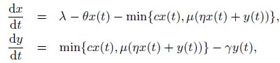
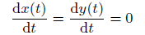
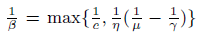
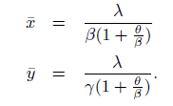
System Evolution
Solving steady state:
Define
"Modeling and Performance Analysis of BitTorrent-Like Peer-to-Peer Networks", SIGCOMM'04
https://conferences.sigcomm.org/sigcomm/2004/papers/p444-qiu1.pdf

Slide 65
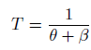
System State
Q: How long does each downloader stay as a downloader?
λ
Key take-away: not scaling inverse with system size (x)
New requests comes, new bandwidth also comes

Slide 66
Outline
Admin and recap
Multi-servers
Application overlays (distributed network applications) to
scale bandwidth/resource (BitTorrent)
distribute content lookup (Freenet, DHT, Chord)

Slide 67

The Content Lookup Problem
N₂
N₁
N₃
Key=“title”
Value=MP3 data…
Internet
?
Client
Publisher
Lookup(“title”)
N₄
N₆
N₅
find where a particular file/content is located
Notes:
1000s of nodes.
Set of nodes may change…

Slide 68
Discussion
How do we solve the content lookup problem now?
What are some general potential approaches for the content lookup problem?

Slide 69
Outline
Admin and recap
Multi-servers
Application overlays (distributed network applications) to
scale bandwidth/resource (BitTorrent)
distribute content lookup (Freenet, DHT)
distributed flooding

Slide 70
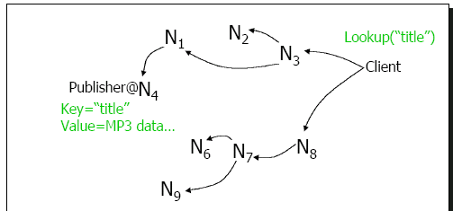
Decentralized Flooding
On startup
client contacts other servents (server + client) in network to form interconnection/peering relationships
Upon receiving a lookup request
send requests to neighbors
neighbors recursively forward the requests

Slide 71
Decentralized Flooding
C
E
F
B
D
M
L
J
A
G
H
S
K
I
N

Slide 72
Decentralized Flooding
send query to neighbors
C
E
F
B
D
M
L
J
A
G
H
S
K
I
N
Each node forwards the query to its neighbors other than the one who forwards it the query

Slide 73
Background: Decentralized Flooding
C
E
F
B
D
M
L
J
A
G
H
S
K
I
N
Each node should keep track of forwarding state to avoid loop !
node state: nodes keep state (which will time out---soft state)
packet state: carry the state in the query, i.e. carry a list of visited nodes

Slide 74
Decentralized Flooding Example: Gnutella
Basic message header
Unique ID, TTL, Hops
Message types
Ping – probes network for other servents
Pong – response to ping, contains IP addr, # of files, etc.
Query – search criteria + speed requirement of servent
QueryHit – successful response to Query, contains addr + port to transfer from, speed of servent, etc.
Ping, Query are flooded
QueryHit, Pong: reverse path of previous message

Slide 75
Advantages and Disadvantages of Decentralized Flooding
Advantages:
totally decentralized, highly robust
Disadvantages:
not scalable; the entire network can be swamped with flood requests
to alleviate this problem, each request has a TTL (time-to-live) to limit the scope
each query has an initial TTL, and each node forwarding it reduces it by one; if TTL reaches 0, the query is dropped (consequence?)

Slide 76
Outline
Admin and recap
Multiple servers
Application overlays (distributed network applications) to
scale bandwidth/resource (BitTorrent)
distribute content lookup (Freenet, DHT)
distributed flooding
distributed routing search

Slide 77
Example: Freenet
History
final year project Ian Clarke , Edinburgh University, Scotland, June, 1999
Goals:
totally distributed system without using centralized index or flooding, instead search by routing
routing/storing system responds adaptively to usage patterns, transparently moving, replicating files as necessary to provide efficient service
provide publisher anonymity, security
free access: resistant to attacks – a third party shouldn’t be able to deny (e.g., deleting) the access to a particular file (data item, object)

Slide 78
Basic Structure of Freenet
Each machine stores a set of files; each file is identified by a unique identifier (called key or id)
Each node maintains a “routing table”
id – file id, key
next_hop node – where to search for a file with id’ that is similar to id
file – local copy, if exists, of file with id
id next_hop file
…
…
…

Slide 79
Freenet Query
id next_hop file
…
API: file = query(id);
Upon receiving a query for file id
check whether the queried file is stored locally
check TTL to limit the search scope
each query is associated a TTL that is decremented each time the query message is forwarded
when TTL=1, the query is forwarded with a probability
TTL can be initiated to a random value (why random value?)
look for the “closest” id in the table with an unvisited next_hop node
if found one, forward the query to the corresponding next_hop
otherwise, backtrack
ends up performing a Depth First Search (DFS)-like traversal
search direction ordered by closeness to target
When file is returned it is cached along the reverse path (any advantage?)
…
…
Notes:
[09/22/2009] Programming assignment 0 is linked on schedule.

Slide 80
Query Example
query(10)
n1
n2
4 n1 f4
12 n2 f12
5 n3
1
9 n3 f9
4’
4
n4
n5
2
14 n5 f14
13 n2 f13
3 n6
5
4 n1 f4
10 n5 f10
8 n6
n3
3
3 n1 f3
14 n4 f14
5 n3
Beside the routing table, each node also maintains a query table containing the state of all outstanding queries that have traversed it → to backtrack

Slide 81
Insert
API: insert(id, file);
Two steps
first attempt a “search” for the file to be inserted
if found, report collision
if not found, insert the file by sending it along the query path (why?)
a node probabilistically replaces the originator with itself (why?)
Notes:
thus inserted files are placed on nodes already possessing files with similar keys

Slide 82
Insert Example
Assume query returned failure along the shown path (backtrack slightly complicates things); insert f10
insert(10, f10)
n1
n2
4 n1 f4
12 n2 f12
5 n3
9 n3 f9
n4
n5
14 n5 f14
13 n2 f13
3 n6
4 n1 f4
11 n5 f11
8 n6
n3
3 n1 f3
14 n4 f14
5 n3

Slide 83
Insert Example
insert(10, f10)
n1
n2
10 n1 f10
4 n1 f4
12 n2
orig=n1
9 n3 f9
n4
n5
14 n5 f14
13 n2 f13
3 n6
4 n1 f4
11 n5 f11
8 n6
n3
3 n1 f3
14 n4 f14
5 n3

Slide 84
Insert Example
insert(10, f10)
n1
n2
10 n1 f10
4 n1 f4
12 n2
10 n1 f10
9 n3 f9
n4
n5
14 n5 f14
13 n2 f13
3 n6
4 n1 f4
11 n5 f11
8 n6
n3
3 n1 f3
14 n4 f14
5 n3

Slide 85
Insert Example
n2 replaces the originator (n1) with itself
insert(10, f10)
n1
n2
10 n1 f10
4 n1 f4
12 n2
10 n1 f10
9 n3 f9
n4
n5
orig=n2
14 n5 f14
13 n2 f13
3 n6
4 n1 f4
11 n5 f11
8 n6
n3
3 n1 f3
14 n4 f14
5 n3

Slide 86
Insert Example
insert(10, f10)
n1
n2
10 n1 f10
4 n1 f4
12 n2
10 n1 f10
9 n3 f9
n4
n5
orig=n2
14 n5 f14
13 n2 f13
3 n6
4 n1 f4
11 n5 f11
8 n6
n3
10 n2 10
3 n1 f3
14 n4

Slide 87
Insert Example
Insert(10, f10)
n1
n2
10 n1 f10
4 n1 f4
12 n2
10 n1 f10
9 n3 f9
n4
n5
10 n2 f10
14 n5 f14
13 n2
10 n4 f10
4 n1 f4
11 n5
n3
10 n2 10
3 n1 f3
14 n4

Slide 88
Analysis: Freenet Dynamics
As nodes process queries, connectivity increases
nodes will discover other nodes in the network
Nodes eventually specialize in locating similar keys
if a node is listed in a routing table, it will get queries for related keys
thus will gain “experience” answering those queries
caveat: lexigraphic closeness of file names/keys may not imply content similarity
Popular data will be transparently replicated and will exist closer to requestors

Slide 89
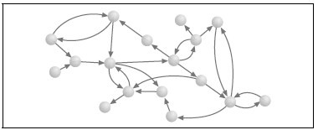
Understanding Freenet Self-Organization: Freenet Graph
id next_hop file
…
…
We create a Freenet reference graph
creating a vertex for each Freenet node
adding a directed link from A to B if A refers to an item stored at B

Slide 90
Experiment: Freenet Graph: Init
id next_hop file
…
…
i-2
i-1
i
i+1
i+2
Assume a network of 1000 nodes, with node id 0 to 999
Each node can store 50 data items, and 200 references
Assume initially each node i has i, and knows the storage of i – 2, -1, i + 1, i + 2 (all mod 1000)
thus a regular, locally-clustered graph with avg path length
~ 1000 / 8 = 125

Slide 91
Example: Search Effect
id next_hop file
…
…
i-2
i-1
i
i+1
i+2
What is the effect that the first search is node 0 searching for item 490 (assume no probabilistic replacement to hide origin)?
Nodes 0, 2, 4, 6, …, 488 all cache item 490, and has a pointer to node 490
The search forms many long-distance links

Slide 92
Experiment: Evolution of Freenet Graph
At each step
pick a node randomly
flip a coin to determine search or insert
if search, randomly pick a key in the network
if insert, pick a random key
Evolution of path length and clustering;
Clustering is defined as percentage of local links

Slide 93
Freenet Evolves to Small-World Network
With usage, the regular, highly localized Freenet network evolved into one irregular graph
Highly-connected nodes provide shortcuts/bridges
make the world a “small world”
most queries only traverse a small number of hops to find the file

Slide 94
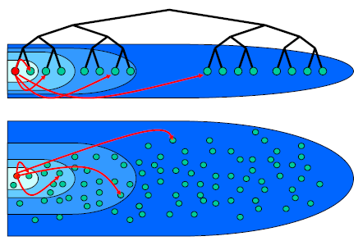
Small-World
First discovered by Milgrom
in 1967, Milgram mailed 160 letters to a set of randomly chosen people in Omaha, Nebraska
goal: pass the letters to a given person in Boston
each person can only pass the letter to an intermediary known on a first-name basis
pick the person who may make the best progress
result: 42 letters made it through !
median intermediaries was 5.5---thus six degree of separation
a potential explanation: highly connected people with non-local links in mostly locally connected communities improve search performance !

Slide 95
Freenet: Summary
Advantages
Many interesting design features
Issues
Does not always guarantee that a file is found, even if the file is in the network
Good average-case performance, but a potentially long search path in a large network

Slide 96
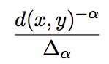
Analysis: Effective, Distributed Routing Search
Question: what kind of long distance links to maintain so that distributed content routing search is effective?
Assume that each node has
a fixed # (say p distance away) local links
a small # (say a total of q) long-distance links s.t. the probability of a link between nodes x and y is some (α) inverse-power of the distance d(x, y) of x and y
Different alpha’s give diff types of links.
Objective: what is a good alpha?

Slide 97
What Should the Long-Distance Links Look?
Consider the simple case of one dimensional space.
Which alpha leads to best performing distributed search alg?
0
1
2
2
n

Slide 98
What Should the Long-Distance Links Look?
For 1-d space, for any distributed algorithm, the expected # of search steps, for different α’s:
0 ≤α < 1 : ≥ k₁n^{(1-α)/2}
α > 1 : ≥ k₁n^{(α-1)/α}
α = 1 : O(log²n) greedy search

Slide 99
Effective, Distributed Routing Search Guideline
In the general case, α should be the dimension
Implication: a guideline on long-distance links: roughly the same number of nodes in each region A1, A2, A4, A8, where A1 is the set of nodes who are one lattice step away, A2 is those two steps away, A4 is four steps away…
probability is proportional to (lattice steps)^{-d}

Slide 100
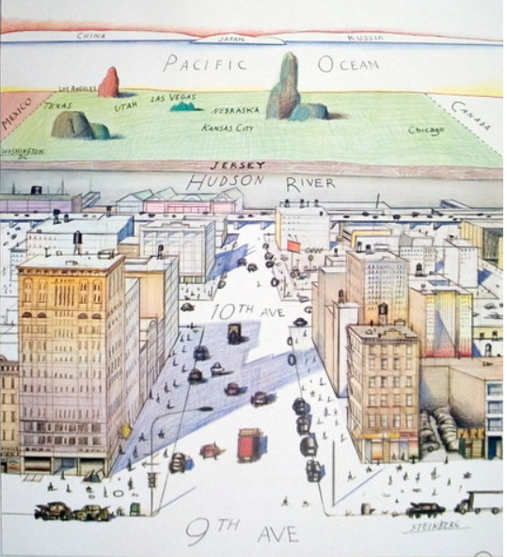
Warped World
Saul Steinberg; View of World from 9th Ave

Slide 101
Outline
Admin and recap
Application overlays (distributed network applications) to
scale bandwidth/resource (BitTorrent)
distribute content lookup (Freenet, DHT)
distributed flooding
distributed routing search
freenet
effective, distributed routing search guideline
distributed hash table (DHT)

Slide 102
DHT: Overview
Abstraction: a distributed “hash-table” (DHT) data structure for distributed, routed, content search
put(key, value) and get(key) → value
DHT imposes no structure/meaning on keys
Distributed application
put(key, data)
get (key)
DHT
node
node
….
node

Slide 103
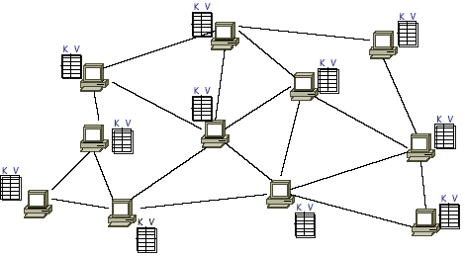
DHT: API

Slide 104
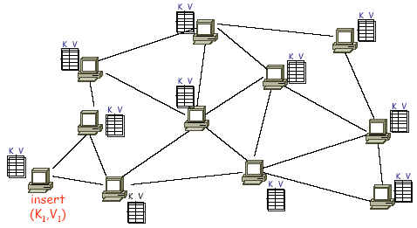
DHT: API (2)

Slide 105
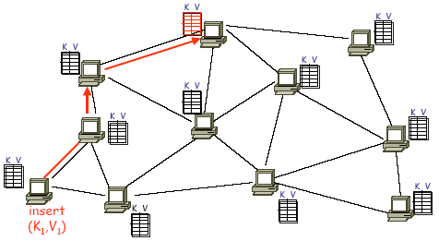
DHT: API (3)
Greedy routing based on routing table

Slide 106
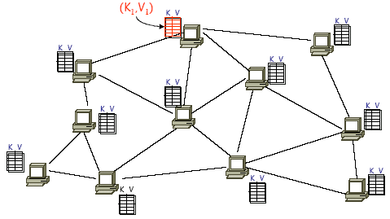
DHT: API (4)

Slide 107
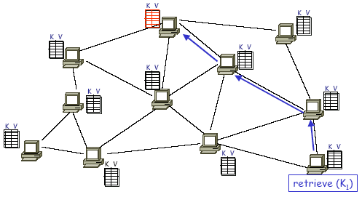
DHT: API (5)

Slide 108
Usage of DHT
File sharing and backup [CFS, Ivy, OceanStore, PAST, Pastiche …]
Web cache and replica [Squirrel, Croquet Media Player]
Censor-resistant stores [Eternity]
DB query and indexing [PIER, Place Lab, VPN Index]
Event notification [Scribe]
Naming systems [ChordDNS, Twine, INS, HIP]
Communication primitives [I3, …]
Host mobility [DTN Tetherless Architecture]
Used as a basic block of Amazon dynamo

Slide 109
DHT Design Pattern
Map key to a space
Each node owns a sub space
Routing table follows the effective distributed routing search guideline

Slide 110
CAN
Abstraction
map a key to a “point” in a multi-dimensional Cartesian space
a node “owns” a zone in the overall space
route from one “point” to another

Slide 111
CAN Example: Two Dimensional Space
Space divided among nodes
Each node covers either a square or a rectangular area of ratios 1:2 or 2:1
1

Slide 112
CAN Example: Two Dimensional Space
Space divided among nodes
Each node covers either a square or a rectangular area of ratios 1:2 or 2:1
1
2

Slide 113
CAN Example: Two Dimensional Space
Space divided among nodes
Each node covers either a square or a rectangular area of ratios 1:2 or 2:1
3
1
2

Slide 114
CAN Example: Two Dimensional Space
Space divided among nodes
Each node covers either a square or a rectangular area of ratios 1:2 or 2:1
3
1
2
4

Slide 115
CAN Example: Two Dimensional Space
Space divided among nodes
Each node covers either a square or a rectangular area of ratios 1:2 or 2:1

Slide 116
CAN Insert: Example (1)
node I::insert(K,V)
I

Slide 117
CAN Insert: Example (2)
node I::insert(K,V)
(1) a = h_{x}(K)
b = h_{y}(K)
I
y = b
x = a
Example: Key=“Matrix3” h(Key)=60

Slide 118
CAN Insert: Example (3)
node I::insert(K,V)
(1) a = h_{x}(K)
b = h_{y}(K)
(2) route(K,V) -> (a,b)
I
y = b
x = a

Slide 119
CAN Insert: Routing
A node maintains state only for its immediate neighboring nodes
Forward to neighbor which is closest to the target point
a type of greedy, local routing scheme

Slide 120
CAN Insert: Example (4)
node I::insert(K,V)
(1) a = h_{x}(K)
b = h_{y}(K)
(2) route(K,V) -> (a,b)
(3) (K,V) is stored at (a,b)
I
y = b
x = a

Slide 121
CAN Retrieve: Example
node J::retrieve(K)
J

Slide 122
CAN Retrieve: Example
node J::retrieve(K)
(1) a = h_{x}(K)
b = h_{y}(K)
(2) route “retrieve(K)” to (a,b)
y = b
J
x = a

Slide 123
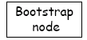
CAN Insert: Join (1)
2) pick a random
point (p,q) in space
J
new node
1) Discover some node “J” already in CAN

Slide 124
CAN Insert: Join (2)
N
J
new node
3) J routes to (p,q), discovers node N

Slide 125
CAN Insert: Join (3)
Inserting a new node affects only a single other node and its
immediate neighbors
N
new node
J
4) split N’s zone in half… new node owns one half

Slide 126
CAN Evaluations
Guarantee to find an item if in the network
Load balancing
hashing achieves some load balancing
overloaded node replicates popular entries at neighbors
Scalability
for a uniform (regularly) partitioned space with n nodes and d dimensions
storage:
per node, number of neighbors is 2d
routing
average routing path is (dn^{1/d})/3 hops (due to Manhattan distance routing, expected hops in each dimension is dimension length * 1/3)
a fixed d can scale the network without increasing per-node state

Slide 127
Chord
Space is a ring
Consistent hashing: m bit identifier space for both keys and nodes
key identifier = SHA-1(key), where SHA-1() is a popular hash function,
Key=“Matrix3” → ID=60
node identifier = SHA-1(IP address)
IP=“198.10.10.1” → ID=123

Slide 128
Chord: Storage using a Ring
K125, K5, K10
IP=“198.10.10.1”
N10
N123
K11, K20
Circular
7-bit ID Space
N32
K101
N90
N55
K60
Key=“Matrix 3”
A key is stored at its successor: node with next higher or equal ID

Slide 129
Exercise
Compare impact of load balancing when adding a new machine, for two content mapping approaches,
Each machine has an index 0-m-1, hash function mapping content to 0-m-1, and assign to corresponding machine
Chord mapping

Slide 130
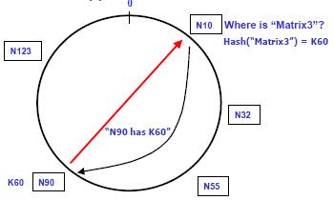
How to Search: One Extreme
Every node knows of every other node
Routing tables are large O(N)
Lookups are fast O(1)

Slide 131
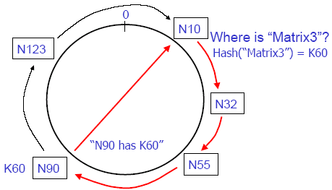
How to Search: the Other Extreme
Every node knows its successor in the ring
If follow the distributed routing search principle, what the routing table may look like?
Routing tables are small O(1)
Lookups are slow O(N)

Slide 132
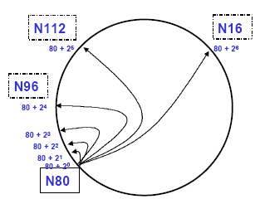
Chord Solution: “finger tables”
Node K knows the node that is maintaining K + 2^{i}, where K is mapped id of current node
increase distance exponentially
K+32
K+64
K+16
K+8
K+4
K+2
K+1
N80

Slide 133
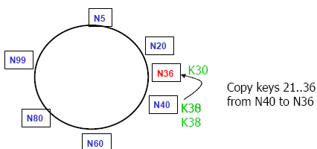
Joining the Ring
use a contact node to obtain info
transfer keys from successor node to new node
updating fingers of existing nodes

Slide 134
DHT: Chord Node Join
Assume an identifier space [0..8]
Node n1 joins
Succ. Table
0
i id+2^{i} succ
0 2 1
1 3 1
2 5 1
7
1
6
2
5
3
4

Slide 135
DHT: Chord Node Join
Node n2 joins
Succ. Table
0
i id+2^{i} succ
0 2 2
1 3 1
2 5 1
7
1
6
2
Succ. Table
5
3
i id+2^{i} succ
0 3 1
1 4 1
2 6 1
4

Slide 136
DHT: Chord Node Join
Node n6 joins
Succ. Table
0
i id+2^{i} succ
0 2 2
1 3 6
2 5 6
7
1
Succ. Table
i id+2^{i} succ
0 7 1
1 0 1
2 2 2
6
2
Succ. Table
5
3
i id+2^{i} succ
0 3 6
1 4 6
2 6 6
4

Slide 137
DHT: Chord Node Join
Node n0 starts join
Succ. Table
0
i id+2^{i} succ
0 2 2
1 3 6
2 5 6
7
1
Succ. Table
i id+2^{i} succ
0 7 1
1 0 1
2 2 2
6
2
Succ. Table
5
3
i id+2^{i} succ
0 3 6
1 4 6
2 6 6
4

Slide 138
DHT: Chord Node Join
Succ. Table
i id+2^{i} succ
0 1 1
1 2 2
2 4 6
After Nodes n0 joins
Succ. Table
0
i id+2^{i} succ
0 2 2
1 3 6
2 5 6
7
1
Succ. Table
i id+2^{i} succ
0 7 0
1 0 0
2 2 2
6
2
Succ. Table
5
3
i id+2^{i} succ
0 3 6
1 4 6
2 6 6
4

Slide 139
DHT: Chord Insert Items
Succ. Table
Items
Nodes: n1, n2, n0, n6
Items: f7, f1
i id+2^{i} succ
0 1 1
1 2 2
2 4 0
7
0
Succ. Table
Items
7
1
i id+2^{i} succ
0 2 2
1 3 6
2 5 6
1
Succ. Table
6
2
i id+2^{i} succ
0 7 0
1 0 0
2 2 2
Succ. Table
5
3
i id+2^{i} succ
0 3 6
1 4 6
2 6 6
4

Slide 140
DHT: Chord Routing
Succ. Table
Items
Upon receiving a query for item id, a node:
checks whether stores the item locally
if not, forwards the query to the largest node in its successor table that does not exceed id
i id+2^{i} succ
0 1 1
1 2 2
2 4 0
7
0
Succ. Table
Items
7
1
i id+2^{i} succ
0 2 2
1 3 6
2 5 6
1
query(7)
Succ. Table
6
2
i id+2^{i} succ
0 7 0
1 0 0
2 2 2
Succ. Table
5
3
i id+2^{i} succ
0 3 6
1 4 6
2 6 6
4

Slide 141
DHT (CAN, Chord) Summary
Each node “owns” some portion of the key-space
in CAN, it is a multi-dimensional “zone”
in Chord, it is the key-id-space between two nodes in 1-D ring
Files and nodes are assigned random locations in key-space
provides some load balancing
probabilistically equal division of keys to nodes
Distributed, greedy routing based alg
node X does not know of a path to a key Z
but if it appears that node Y is the closest to Z among all of the nodes known to X
so route to Y

Slide 142
Backup Slides

Slide 143
Outline
Admin and recap
Application overlays (distributed network applications) to
scale bandwidth/resource (BitTorrent)
distribute content lookup (Freenet, DHT)
distribute content verification (Block chain)
Notes:
https://bitcoin.org/bitcoin.pdf

Slide 144
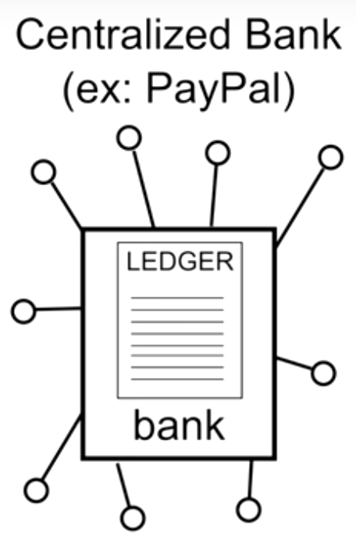
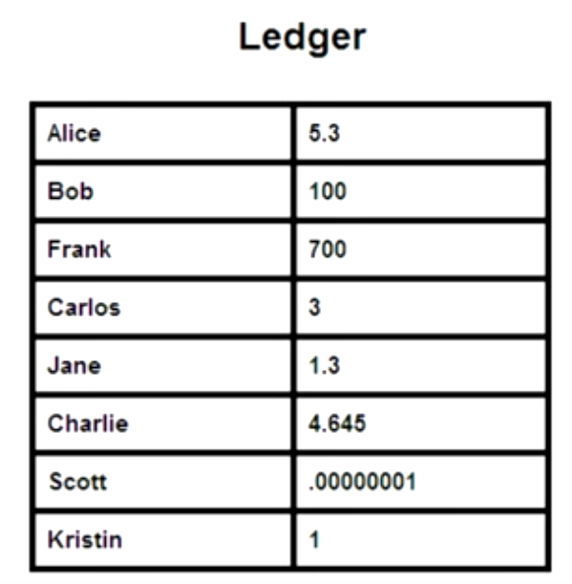
Motivation: Centralized Clearing House of Financial Transactions
Function:
sees all transactions
with its centralized ledger
be able to verify validity of each transaction, e.g., no double-spending
Problem
single point of trust (attack, charge)
Source: https://www.slideshare.net/JrmeKehrli/the-blockchain-the-technology-behind-bitcoin

Slide 145
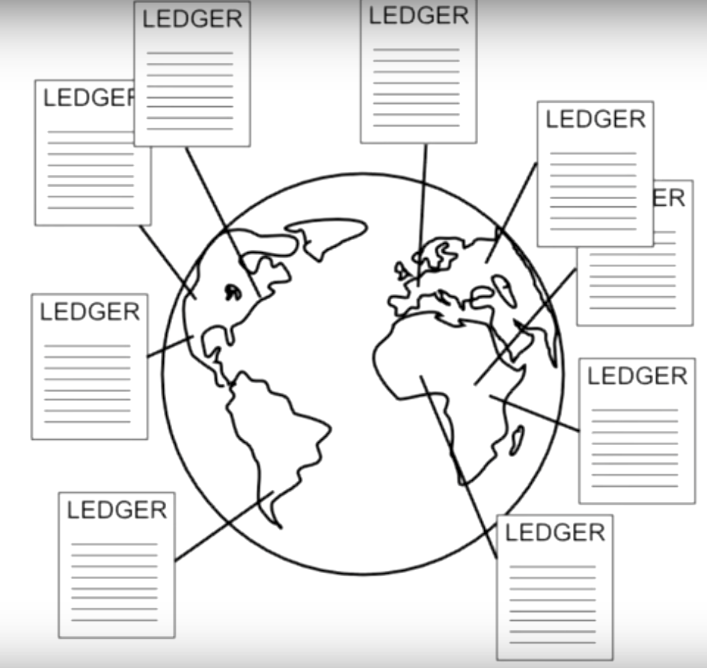
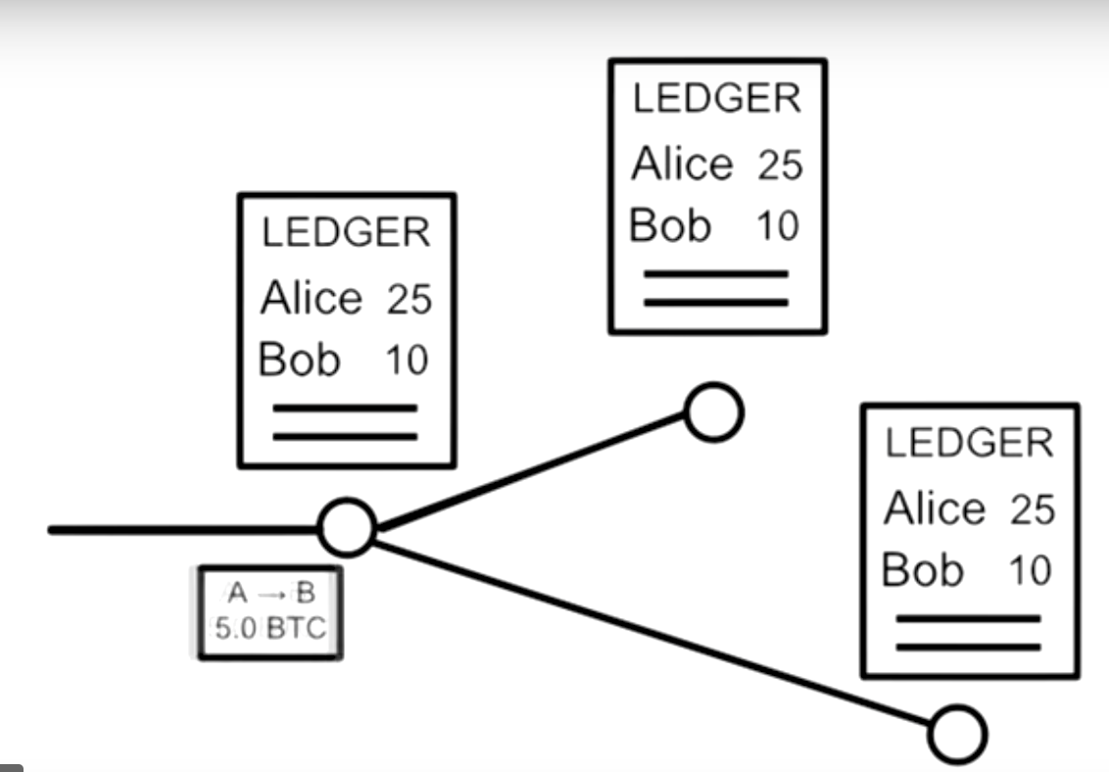

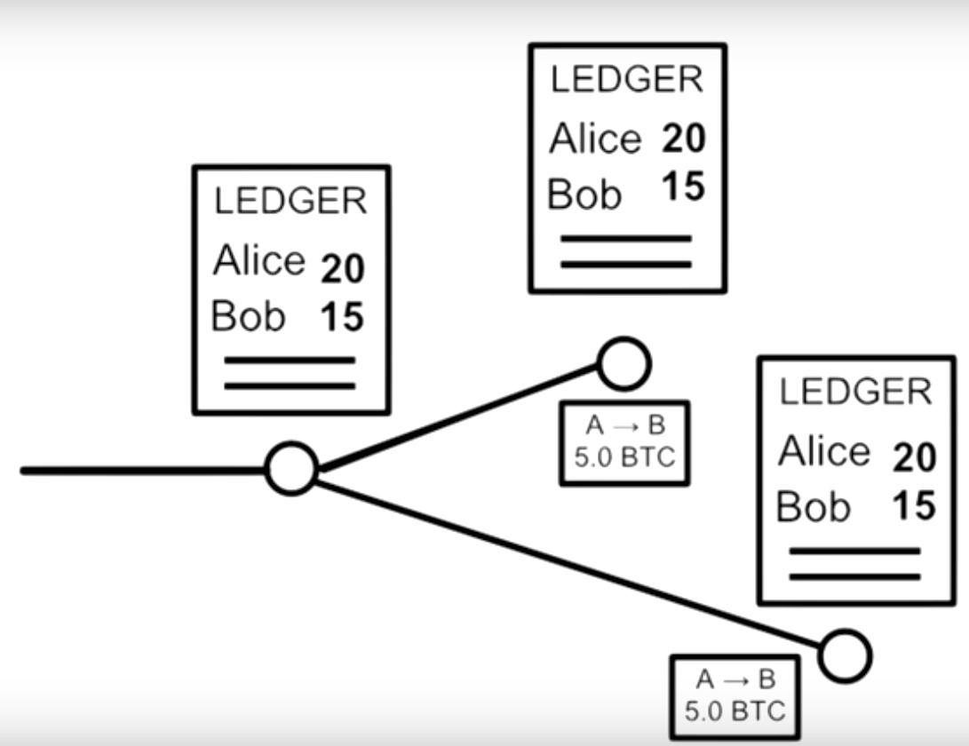
Motivation: Distributed Ledgers

Slide 146
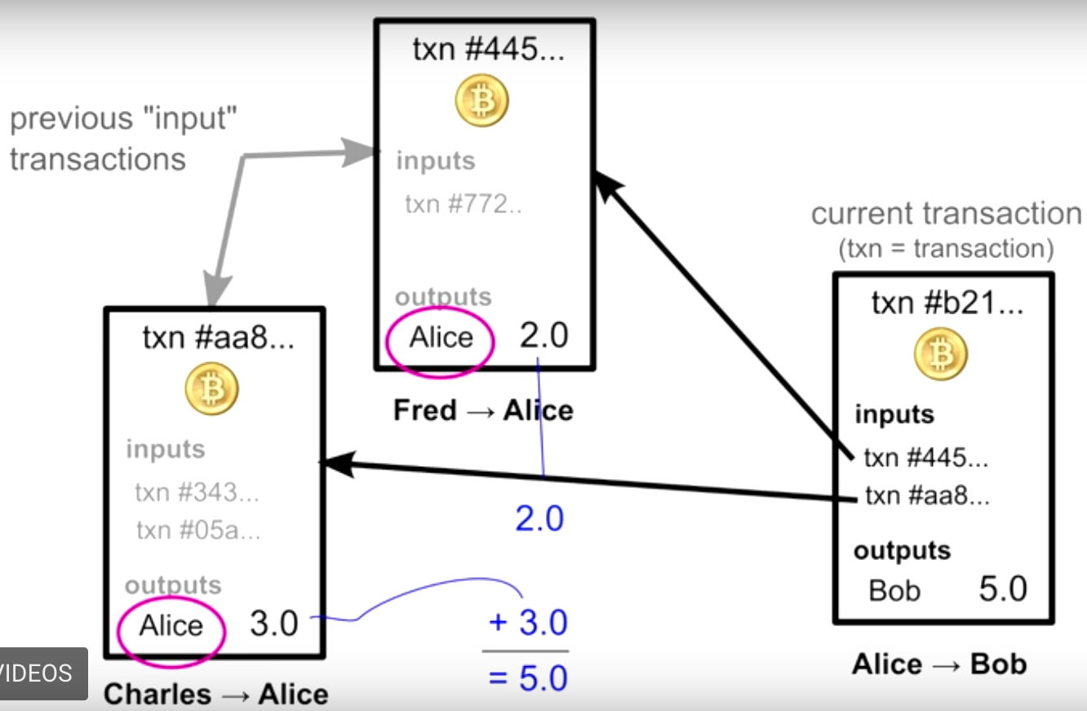
BitCoin Details: Transaction Chains

Slide 147
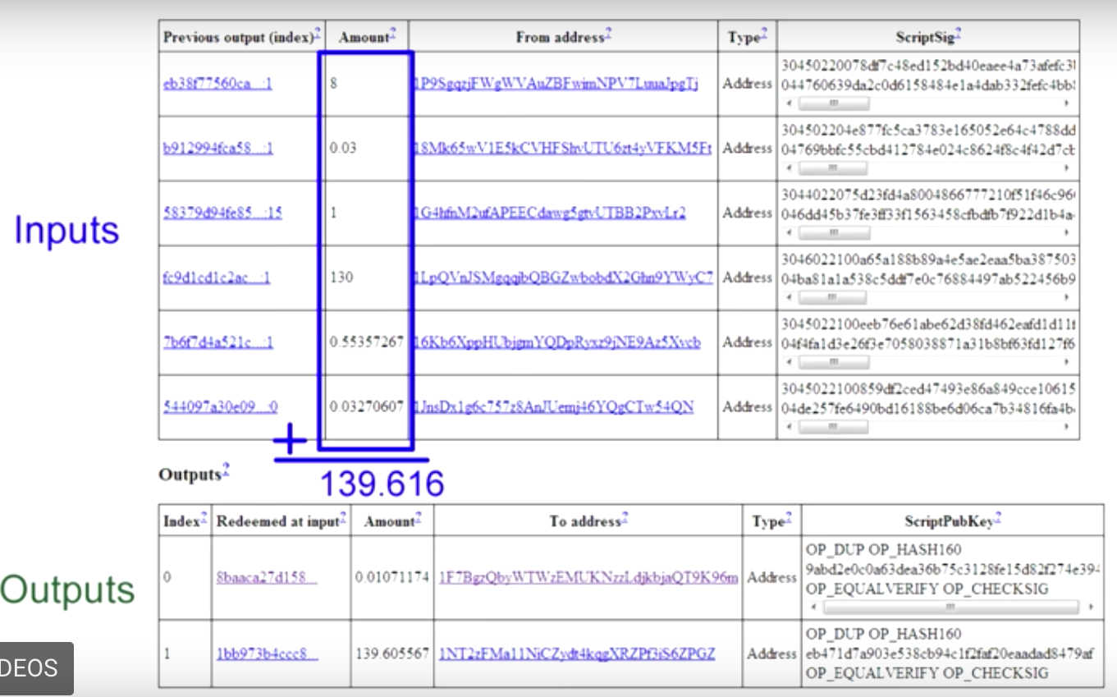
BitCoin Details: Transaction Chains

Slide 148
Motivation
Main problem
Avoid faked entries of ledgers

Slide 149
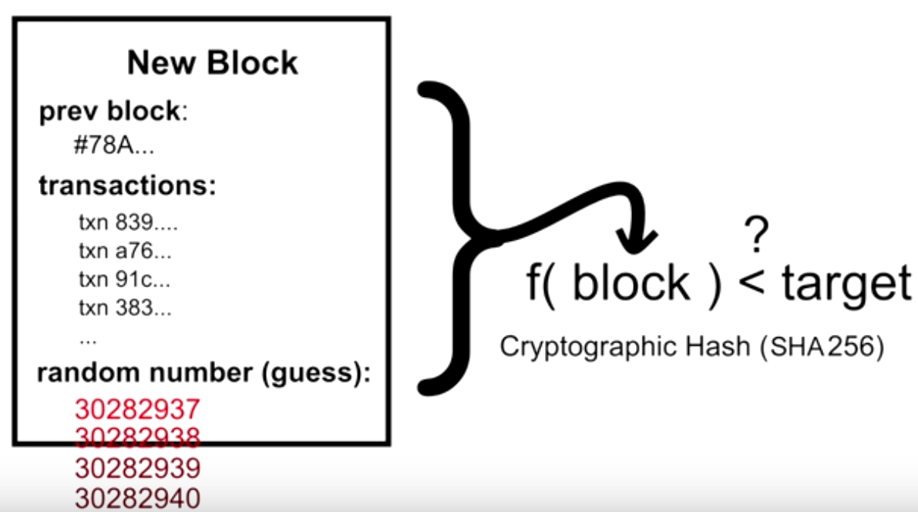
Block Chain: Basic Ideas
Make each entry difficult to create: Block Puzzle

Slide 150
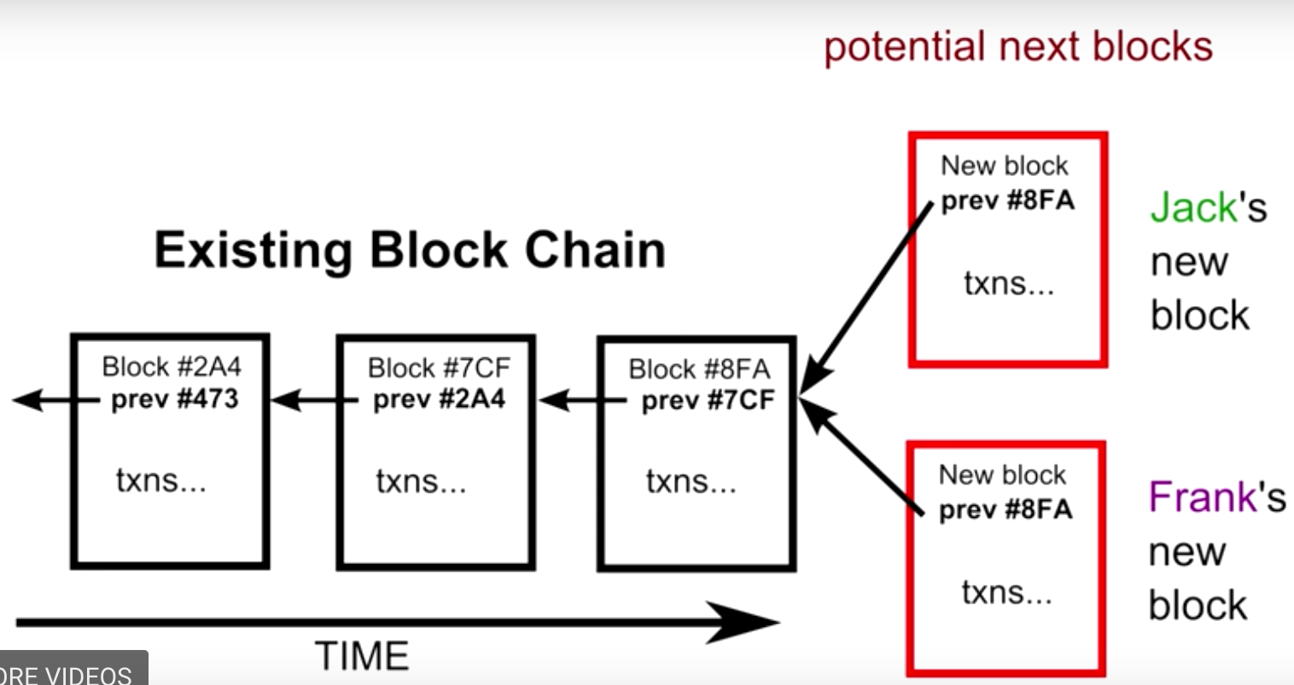
Block Chain: Basic Ideas
Chain the blocks to make any creation of a new block needs to re-do all work

Slide 151
Outline
Admin and recap
Application overlays (distributed network applications) to
scale bandwidth/resource (BitTorrent)
distribute content lookup (Freenet, DHT)
distribute content verification (Block chain)
Notes:
https://bitcoin.org/bitcoin.pdf

Slide 152
Outline
Admin and recap
Application overlays (distributed network applications) to
scale bandwidth/resource (BitTorrent)
distribute content lookup (Freenet, DHT)
achieve anonymity (Tor)

Slide 153
Problem
Internet surveillance like traffic analysis reveals users privacy
Encryption does not hide packet headers, which still reveal a great deal about users
End-to-end anonymity is needed
Solution: distributed, anonymous networks

Slide 154
Example: Tor Networks
Basic idea
Overlay network using Onion Routers (OR)
Onion routing so that each onion router knows only the previous and next hop
https://torstatus.blutmagie.de/

Slide 155
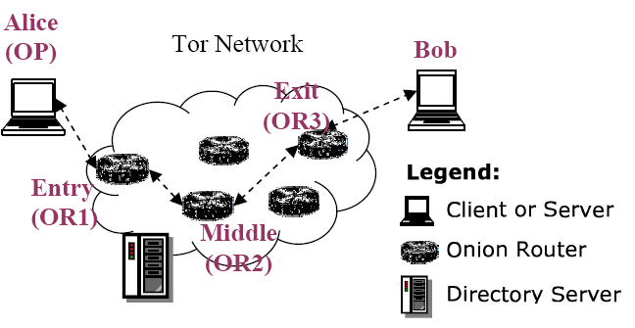

Tor Components
Client: the user of the Tor network
Server: the target TCP applications such as web servers
Tor (onion) router: the special proxy relays the application data
Directory server: servers holding Tor router information

Slide 156
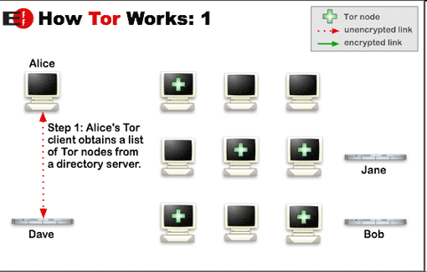
Tor Steps

Slide 157
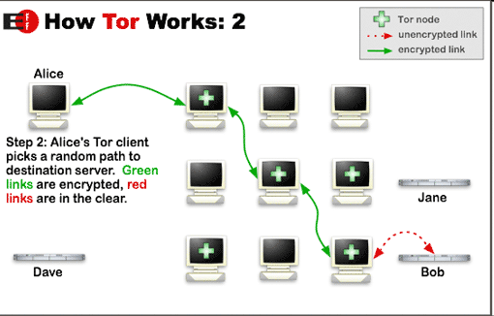
Tor Steps

Slide 158
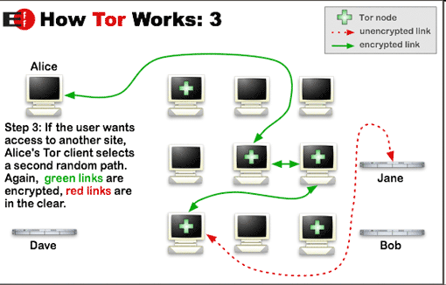
Tor Steps

Slide 159
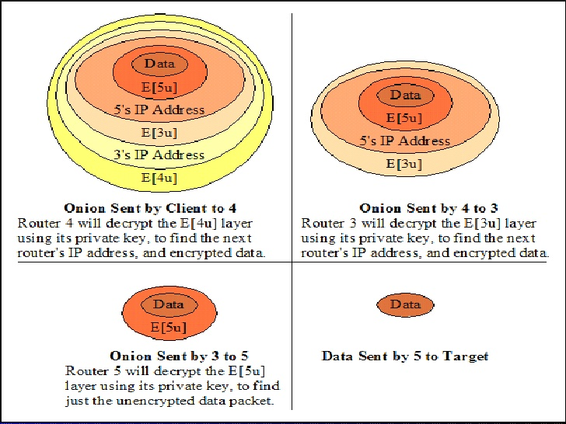
Tor Networks
Onions using public key
Basic idea
Overlay network using Onion Routers (OR)

Slide 160

Tor Optimization: Symmetric Key
Alice
Bob
C2
√
M
M
OR2
C3
M
M
C1
OR1
OR3
A circuit is built incrementally one hop by one hop
Onion-like encryption
Alice negotiates an AES key with each router
Messages are divided into equal sized cells
Each router knows only its predecessor and successor
Only the Exit router (OR3) can see the message

Slide 161
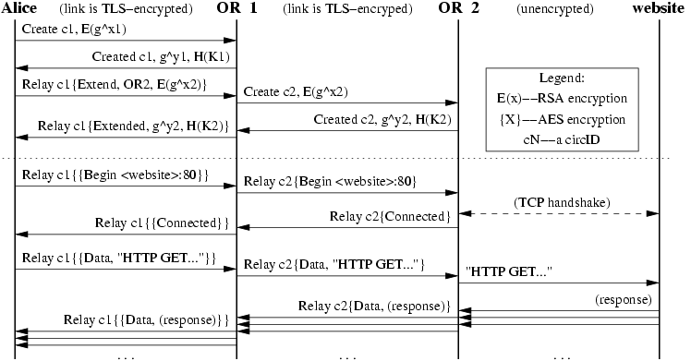
Example Tor Commands

Slide 162
Tor Location-Hidden Service
Goal: allow one to offer a TCP service without revealing his IP address
Access Control: filtering incoming requests
Robustness: maintaining a long-term pseudonymous identity
Smear-resistance: against socially disapproved acts

Slide 163
Tor Location-Hidden Service: Creating and Connecting to a Location Hidden Service
Notes:
Rendezvous Points in Tor
User 1 generates a long-term public key pair to identify his service.
User 1 chooses some introduction points, and advertises them on the lookup service, signing the advertisement with his public key.
User 1 builds a circuit to each of his introduction points, and tells them to wait for requests.
User 2 learns about User 1 ’s service out of band (perhaps via lookup service If user 2 wants to access User 1 ’s service anonymously, she must connect via Tor to the lookup serivce.
User 2 chooses an OR as the rendezvous point for her connection to user 1’s service. She builds a circuit to the RP, and gives it a randomly chosen “rendezvous cookie” to recognize user 1.
User 2 opens an anonymous stream to one of user 1’s introduction points, and gives it a message (encrypted with User 1’s public key) telling the RP and rendezvous cookie, and the start of a DH handshake. The introduction point then sends the message to user 1.
If User 1 wants to talk to user 2 he builds a circuit to user 2’s RP and sends the rendezvous cookie, the second of half of the DH handshake, and a hash of the session key they now share. By the same argument, this enables user 2 of knowing she shares the key only with user 1.
The RP connects user 2’s circuit to user 1’s. at this point the RP can’t recognize user 2, user 1, or the data they transmit.
User 2 sends a relay begin cell along the circuit. It arrives at user 1’s OP, which connects to user 1’s web server.
An anonymous stream has been established, and user 2 and user 1 can now communicate as normal.

Slide 164
Backup Slides

Slide 165

Strawman: Central Index: Publish (based on Napster)
insert(X,
123.2.21.23)
...
Publish
I have X, Y, and Z!
123.2.21.23

Slide 166
Central Index: Search
123.2.0.18
search(A)
-->
123.2.0.18
124.1.0.1
Query
Reply
124.1.0.1
Where is file A?

Slide 167
Central Index: Ping
123.2.0.18
ping
124.1.0.1
ping

Slide 168
Central Index: Fetch
123.2.0.18
124.1.0.1
fetch

Slide 169
Napster Messages
General Packet Format
[chunksize] [chunkinfo] [data...]
CHUNKSIZE:
Intel-endian 16-bit integer
size of [data...] in bytes
CHUNKINFO: (hex)
Intel-endian 16-bit integer.
00 - login rejected
02 - login requested
03 - login accepted
0D - challenge? (nuprin1715)
2D - added to hotlist
2E - browse error (user isn't online!)
2F - user offline
5B - whois query
5C - whois result
5D - whois: user is offline!
69 - list all channels
6A - channel info
90 - join channel
91 - leave channel
…..

Slide 170
Centralized Index
Advantages
simplicity, easy to implement sophisticated search engines (boolean exp) on top of the index system
Disadvantages
lack of robustness, scalability: central search server single point of bottleneck/failure
easy to take down !

